Slide 1
A Peek Into
GITHUB COPILOT HARNESS in Copilot Studio
Copilot Studio User Group – Brisbane, Australia
Notes:
Welcome
Thanks to Girish and Nehal
Tremendous job on all the knowledge you share
Need of the hour for sessions and demos
Not just agents but also apps
Copilot Managed Runtime
Copilot Credits
Usage based billing
First part – Understanding harness and diff b/w GHCP & Standard
Second part - Demo

Slide 2


SANDEEP ANGARA
Technology Consultant
hisandeepangara.github.io
linkedin.com/in/sandeep-angara/

Slide 3

HARNESS
Cambridge Dictionary defines:
a piece of equipment with straps and belts, used to control or hold in place a person, animal, or object
“A harness is the operating layer between the model and the agent’s configuration.”
Notes:
The same meaning can be applied in the case of Copilot Studio
A harness is the runtime environment around the model. It determines which capabilities are available, what context reaches the model, how responses are interpreted, and how actions are executed. Orchestration is one job the harness performs: directing what the agent should do next.
Model reasons and generates, harness provide operating environment, orchestration directs the flow of work inside it. Today there are three types of harness in Copilot Studio 1. GHCP, 2. Standard, 3. Copilot Chat each serves different agent orchestration methods.

Slide 4
GHCP Harness Capabilities
Agentic loop
Long running
Adapt
Large file processing
Out-of-the-box
Document generation editing
Notes:
Well this session is exclusively about the GHCP harness, so we will jump into it and see what abilities it have: Agentic loop: the continuous invocation of model for reasoning the agent tries to reason over the goal completion, whether to try a different approach, delegate work or stop. Long running processes like reasoning over spread sheets, reconciliation etc. Adapt – Meaning when anything fails the agent adapts itself, reasons over the failure, retry or try completely a different approach, Large files by size can be processed. Theres a sandbox with bash and python modules installed that supports this. Also out-of-the-box it comes with file generation and editing capabilities. No API calls required, it creates Python scripts using different document generation libraries to do this job.

Slide 5
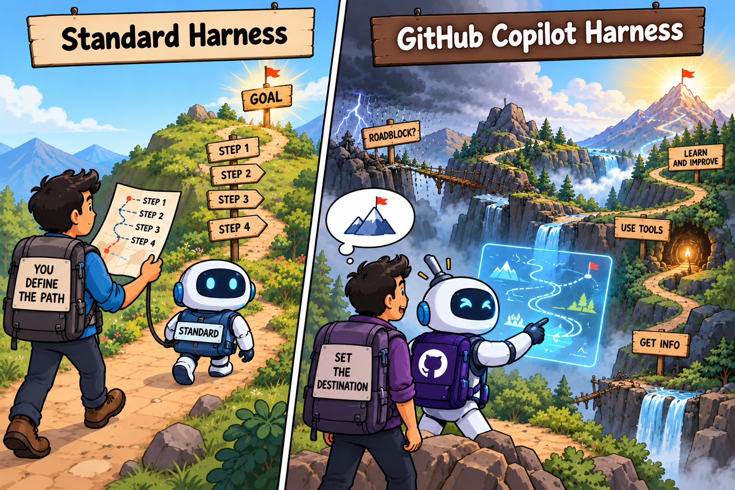
Standard HARNESS builds a plan, then runs it. The GHCP HARNESS Keeps deciding from the latest state.
Standard vs GitHub Copilot harness
Notes:
Before going deep into the GHCP capabilities, let’s now understand the difference between standard and GHCP harness. For a simple analogy consider a very capable GPS: You know the destination to reach, and also the capability to decide which route to take. Now consider a destination you know and doesn’t know well-defined route upfront, now consider having an experienced expedition guide, who figures out routes on ground, know how to handle roadblocks and powerful and patience enough to reach the destination despite of all the issues without leaving in the middle.

Slide 6
Standard HARNESS builds a plan, then runs it. The GHCP HARNESS Keeps deciding from the latest state.
Standard vs GitHub Copilot harness
Standard harness: plan -> execute
GHCP harness: Continuous Thought -> Action -> Observation
1. INTENT
2. PLAN
3. EXECUTE
Understand the request
Synthesize a multi-step workflow
Run authored steps
THOUGHT
ACTION
Reason over the latest state
Call a tool
Explicit plan object
latest
state
Collect inputs
Execute action (connector, topic, query data, …)
Response: summarize
DECIDE
OBSERVE
Choose the next step live
Read the tool result
Less live replanning, easier to inspect
Best fit: broad problem spaces that cannot be fully mapped upfront, like querying a complex data model with many unknown fields.
Best fit: broad problem spaces that cannot be fully mapped upfront, like querying a complex data model with many unknown fields.
Notes:
This slide explains the same technically: Standard harness plans upfront and follows the replanning of the approach in the middle of the flow is very less. Then the GHCP approach is more dynamic: Given a goal, it continues to reason over the progress, scope to invoke other tools in parallel or to redefine the approach completely.

Slide 7
Mapping standard capabilities to the GitHub Copilot harness
1 of 2 · What you can still do, what changed, and where there is no equivalent yet.
What you want to do | In standard harness | In GHCP harness
Drive the conversational flow | Authored topics plus LLM-generated questions, one tool input at a time. | Agent-level instructions and reusable skills; the agent decides what to ask and when.
Transform data | Inline Power Fx formulas for deterministic logic. | Code Execution in the Agent Sandbox, or helper code in a tool or skill, but it is Python/bash, less approachable for low-code makers than Power Fx. Delegating to a workflow is also an option.
Use known context about the user e.g. department, role, channel | System / environment variables load user context and reference it deterministically throughout the conversation. | No system variables; instead, instruct the agent to call a tool that fetches the context before it responds.
Intercept user messages and agent responses e.g. capture incoming user messages, transform the agent response before it is sent | System topics and triggers (such as On message received, On AI response generated) shape messages. | No general intercept point yet; a plan for hooks is being worked on.
Make an ungrounded LLM call | Prompts provide ungrounded LLM calls for tasks like intent classification, sentiment analysis, and summarization. | GHCP-harness agents are much more adherent to instructions, so they can perform these tasks directly from instructions, without dedicated prompts.
Notes:
Going further down, these are the standard capability differences between both harness.

Slide 8
Mapping standard capabilities to the GitHub Copilot harness
2 of 2 · Where there is a gap or something upcoming, mostly a question of how easy the workaround is.
What you want to do | In standard harness | In GHCP harness
Display UI components | Adaptive Cards render a deterministic card experience. | Active work being done on identifying a suitable framework for rich UI components
Capture user input via UI components | Adaptive Cards with input fields collect structured input. | Active work being done on identifying a suitable framework for rich UI components
Restrict to grounded knowledge only | Toggle to disable general / LLM knowledge and force grounded answers. | By design not offered, GHCP-harness agents have the autonomy to decide when to generate content or ask.
Read files and run real computation on data | Code Interpreter (preview) is limited: one file per prompt, no multi-turn questions, no system commands, and timeouts on large datasets. It can only be used to generate python code, and only when the orchestrator decides. Admins must enable it per environment, and it can't be called from a topic. | Full Shell access with Python runtime in an isolated container (Agent Sandbox), no single-file limit, multi-turn capable, on by default. It’s also a workspace that can store temporary files produced by the agent during the current run, and it’s always available for the agent.
Notes:
Today there are also few limitations the GHCP harness lacks like adaptive cards or ui components

Slide 9
SKILLS
Notes:
To drive the conversation/actions flow, we have Skills

Slide 10
AGENTS · BUILDING · SKILLS
Skills: instructions on demand
A maker's guide: when to reach for a Skill, what goes in it, and what to avoid.
WHY USE A SKILL
SKILL.md
name + description = routing metadata
AVOID
Maintainability
Vague descriptions
Keep the agent instructions readable, so a person can follow what it does one focused Skill at a time.
Skill Instructions
the core
Examples
show, don't tell
Weak routing signals make a Skill mis-fire or never trigger.
Mega-skills
Efficient context use
Resources
files, templates
Scripts
executable code
Broad, do-everything scope blurs intent and overlaps others.
Instructions load only when the scenario needs them, instead of on every single turn.
Fact dumps
Metadata sits in context by default. Full content loads only when a scenario matches.
A Skill guides; it does not replace a Knowledge source.
Accuracy, in some cases
Unreviewed Skills
A large always-on prompt makes the model weigh irrelevant guidance every turn, which can reduce accuracy. A Skill loads only what the task needs.
Treat AI or community Skills as untrusted code: review first.
A Skill is just instructions and resources, loaded on demand. Keep it scenario-specific, name it precisely, and test that it fires.
Reusable assets, like skills, instructions, and descriptions, still need evaluation per runtime and model combination.
Notes:
Topics are not a limitation though. Skills though they cannot be compared eith topics dot to dot, Skills are more interesting and solved problem differently. In topics maker determines the path using different nodes like questions, branches, messages and adaptive cards. Skill is more of a reusable piece of task defined. It is basically a markdown file that defines how a granular task to be achieved. Example: In a typical hiring assistant agent a skill that determines how to evaluate a candidate profile Technically: it defines rules, lists the tools to call, how to interpret inputs and outputs from other skills or tools. Skills are not just md. They also support a zip format. You can format a skill into multiple markdown files along with any scripts to achieve a task. Let’s say a agent

Slide 11
SANDBOX
Notes:
Sandbox is the tool GHCP harness uses for large-file processing, ootb file generation and editing.

Slide 12
AGENTS · BUILDING · AGENT SANDBOX (CODE EXECUTION)
Agent Sandbox: execute code when reasoning is not enough
The orchestrator can write and run scripts in an isolated Linux/Python workspace for deterministic work inside the loop.
What the agent can do inside the sandbox
agent-sandbox:~/work
$ python analysis.py
> import pandas as pd, matplotlib.pyplot as plt
> df = pd.read_csv('/mnt/data/orders.csv')
> df.groupby('region').sales.sum().plot.bar()
> plt.savefig('regional-sales.png')
$ python build_report.py --pptx
✓ created report.pptx + chart image
Run commands: Bash/Linux utilities for local file, table, and validation tasks.
Write scripts: Python code for repeatable logic, transformations, and calculations.
Generate artifacts: charts, PowerPoint/Word/Excel/PDF files, cleaned datasets, and images.
Used automatically when: the task needs exact computation, parsing, validation, or file creation.
Here’s some preinstalled libraries...
Data & charts: pandas, numpy, matplotlib, plotly
Files: openpyxl, pptx/docx, pypdf
Parsing/OCR: BeautifulSoup, lxml, pdfplumber, Pillow, OpenCV
Math/logic: sympy, PyYAML, Jinja2, reportlab
No outbound internet: external activities should go through Tools and Knowledge so DLP policies apply.
Use the sandbox for deterministic execution — calculations, file generation, parsing, charts, and validation the model should not improvise.
Notes:
This comes with pre-loaded python libraries like beautiful soup, numpy etc. Its capable of generating code dynamically with the power of Sandbox. Scaffolding scripts inside skill.zip required for an agent we know way before reduces the load on reasoning and generating the code from scratch.

Slide 13
WORKFLOWS
Notes:
Workflows are the new offering part of GHCP harness, though it doesn’t have anything to do with the harness, because these are deterministic but they still consume usage based consumption because of the fact that they enable out of the box AI actions like classification, human in the loop and in-line agents.

Slide 14
From autonomous agents to agentic automation in workflows
An autonomous agent runs a process freely. A workflow runs a process deterministically, using AI when needed.
AUTONOMOUS AGENT
BEFORE
WORKFLOW
NOW
Too much control handed over to the LLM, which chooses the next best action
Human recovers control of the process path, which is rule-based
Inconsistent outputs result from
dynamically selecting tools and tasks
Consistency gains from the deterministic sequence of tools or tasks
Cannot enforce guardrails, left to the
agent’s interpretation of instructions
Guardrails are embedded by design
through logic and human-in-the-loop
Difficult to trace with no visualization of the process and the agent’s trajectory
Easy to trace and monitor the process, represented as steps in the visual canvas
Dynamic path makes cost unpredictable
Deterministic path makes cost predictable
Workflows keep the structure of agent flows and add the intelligence of agents, without the unpredictability

Slide 15
DEMO

Slide 16
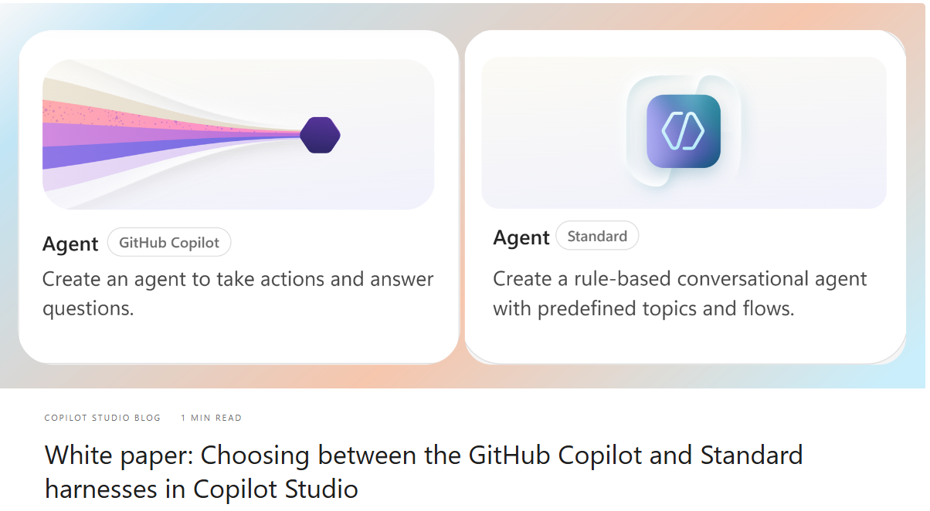
WHITE PAPER
Notes:
White paper: Choosing between the GitHub Copilot and Standard harnesses in Copilot Studio | Microsoft Community Hub

Slide 17
RESOURCES
TECHNICAL
DEEP DIVE DECK
THE CUSTOM ENGINE BLOG
AGENT ACADEMY
SKILLS GALLERY
Notes:
Technical Deck: Microsoft LiveSend
Custom Engine Blog: The Custom Engine
Agent Academy: Copilot Studio Agent Academy | Agent Academy
Sills Gallery: CAT Agent Skills

Slide 18
THANK YOU

